Slide 1

Working with Robot Class in selenium

Slide 2
Introduction
Robot class is a separate class in Java which will allow us to perform multiple tasks based on requirement.
It generally will throw AWT exception.

Slide 3
Benefits of Robot Class
The benefits of robot class are:-
Robot Class can simulate Keyboard and Mouse Event.
Robot Class can help in upload/download of files when using selenium web driver
Robot Class can easily be integrated with current automation framework (keyword, data-driven or hybrid).

Slide 4
Methods and Usage of Robot Class
Robot Class methods can be used to interact with keyboard/mouse events while doing browser automation.
Some methods of Robot Class used during web automation are:-
keyPress(): -This method with press down arrow key of Keyboard.
mousePress():-This method will press the right click of mouse.
mouseMove():-This will move mouse pointer to the specified X and Y coordinates.
keyRelease():-This method with release down arrow key of Keyboard.
mouseRelease():-This method will release the right click of mouse.

Slide 5
Now see the code here:-
package com.esteyaqueSelenium.SeleProg;
import java.awt.AWTException;
import java.awt.Robot;
import java.awt.event.KeyEvent;
import org.openqa.selenium.By;
import org.openqa.selenium.WebDriver;
import org.openqa.selenium.firefox.FirefoxDriver;
import org.testng.annotations.Test;
public class RobotClass
{
@Test
public void robotandselenium() throws InterruptedException
{
WebDriver driver=new FirefoxDriver();

Slide 6
Robot robot=null;
driver.get("http://www.makemytrip.com");
driver.manage().window().maximize();
driver.findElement(By.xpath(".//*[@id='ssologinlink']")).click(); driver.findElement(By.xpath(".//*[@id='username']")).sendKeys("username@gmail.com"); driver.findElement(By.xpath(".//*[@id='password_text']")).sendKeys("password");
Try
{
robot=new Robot();
}
catch (AWTException e)
{
e.printStackTrace();
} //Keyboard Activity Using Robot Class
robot.keyPress(KeyEvent.VK_ENTER);
} }

Slide 7
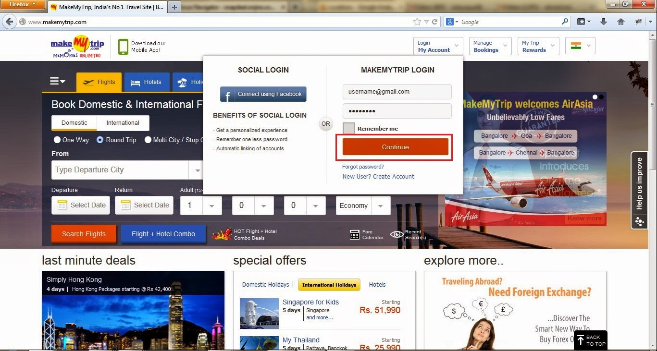
Output:-

Slide 8
Disadvantages of Robot Class
Disadvantages of Robot Class are:-
Keyword/mouse event will only works on current instance of Window. E.g. suppose a code is performing any robot class event, and during the code execution user has moved to some other screen then keyword/mouse event will occur on that screen.
Most of the methods like mouseMove is screen resolution dependent so there might be a chance that code working on one machine might not work on other.

Slide 9
Covered Till Now
Robot class in AWT package is used to generate keyboard/mouse events to interact with OS windows and native apps.
The primary purpose of Robot is to support selenium automated tests project build in Java platform
Disadvantages of robot class

Slide 10
Thanks

